Slide 1
2018 Email Management for FXE Swim Team
September 1, 2018
FXE Racquet and Swim Club

Slide 2
FXE Email Management
This training will cover:
The email schedule and routine during a season.
Our email vendor.
How to navigate the email vendor site.
How to create and edit an email list
How to create and edit an email.
How to send an email.

Slide 3
Email Schedule and Routine During Swim Season
Broadly the email schedule is:
Introduction email in March – April.
Registration Announcement email. April - May
Registration reminder emails (several). April May
Practice schedule email. April May
Inter squad meet email: details. May
Inter squad meet email: event and heat sheets email. June
Inter squad meet email: Results. June
Swim Meet emails follow same pattern: June
Before meet: send details email.
Before meet: if can, send heat sheet and event sheet email link in details email, but more often than not need to send a separate email because heat sheets not ready. Sometimes you will need to send a couple heat sheet emails as the coaches make changes.
After Meet: results email.
Various socials emails. June
Year round swim team email announcements. June
All Star Meet emails follow same pattern as swim meet emails. July
End of year banquet announcement email. July

Slide 4
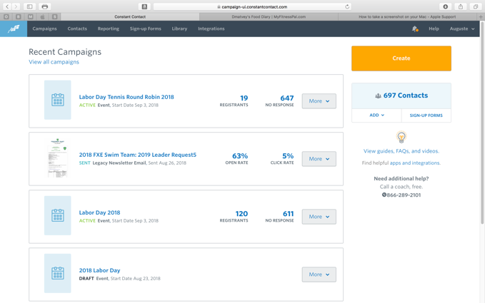
Our Vendor: Constant Contact
Our email vendor and the email vendor for the club is: Constant Contact. Please ask board or swim rep for login and password.
https://www.constantcontact.com/account-home
When you log in you will see the main page: The default is “Recent Campaigns”
An email you send to a distribution is called a “campaign.”
You can track responses and percentages.
Next select “View all Campaigns.” or can always click “Campaigns.”

Slide 5
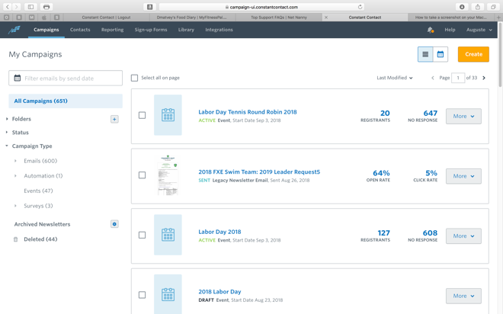
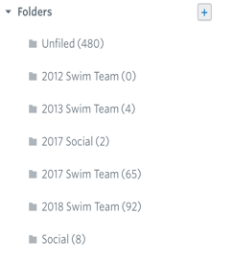
Main Menu Screen
Main menu screen is made up of a couple components would will need:
Contacts: for email lists
Folders: This is where all 2018 Swim team emails are archived
Library: where pictures and documents are housed for inclusion in an email,
When expand folders:

Slide 6
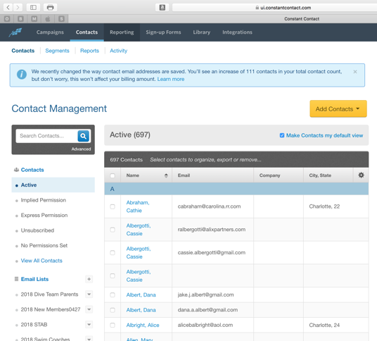
Contacts Screen
Recall we share this email system with the entire FXE family including Dive and Tennis teams. So be careful not to edit existing email distributions. Only edit/delete Swim related lists.
Remember that in order to be on swim team, you need to be a member, so the emails will be in the system.
The new email list comes from the registration excel file from the website. Once you get that excel you can cut out all the columns except emails and save as text file and upload file.
Let’s create a new email list.

Slide 7
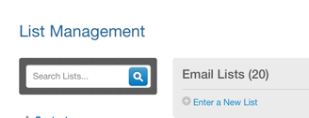
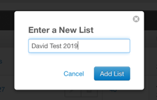
New Email Distribution.
To add a new email distribution list for the season, first click on Enter a new List.
Type in a name
Then List will appear with no emails in the list.

Slide 8
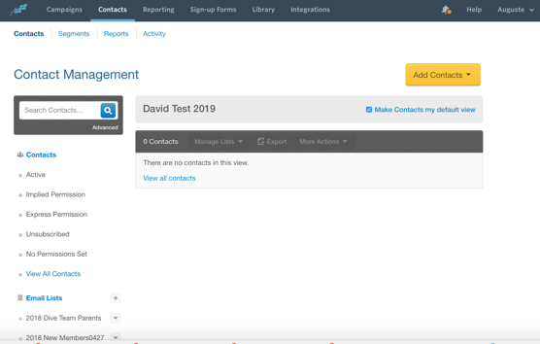
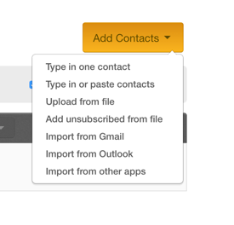
New Email Distribution. Cont.
Now add contacts.
You can add them one by one or upload a file.

Slide 9
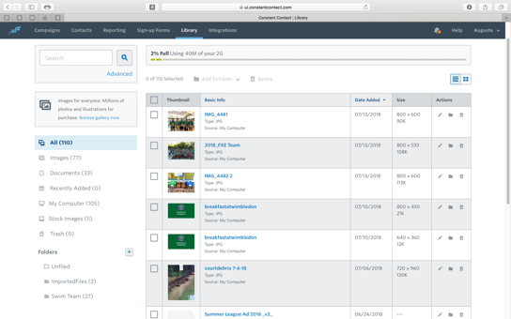
Library
This is where you can upload pictures or documents to use in your email. There is a folder for swim Team. Straightforward upload function.
So if some send you a document to use, you can upload it in Constant Contact and create a link from the system in your email.

Slide 10
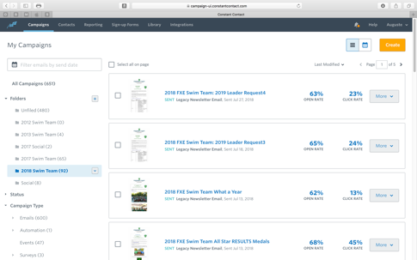
Creating an email
You don’t have to create one from scratch. Simply find the topic you want and copy it. Then modify it for your season. So in this example, I need to send a the Inter squad Meet info email.
Just follow the format for last year’s emails and you will be fine. It already will give you direction of what to include.
First go to folders / Swim team. The window will show all the emails in chronological order. We are scrolling to fid the inter squad one.

Slide 11
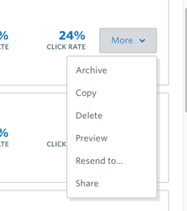
Creating an email Cont.
OK we found last year’s inter squad meet email
Then under More we want to select COPY

Slide 12
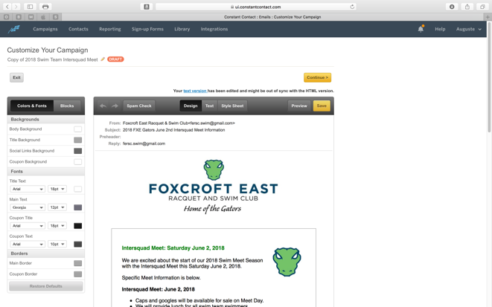
Creating an email Cont.
A new copy of the email comes up.
Change the name of the email.
Then click into the body of the email and edit

Slide 13
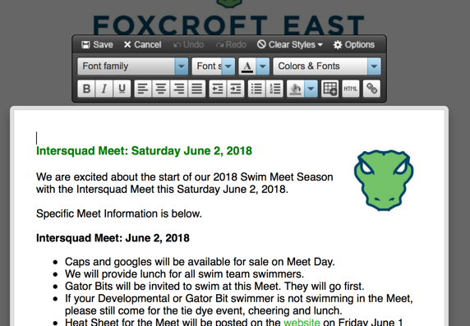
Creating an email Cont.
Editing is straightforward. When click into the body of the email, an editing toolbar is ready for use.

Slide 14
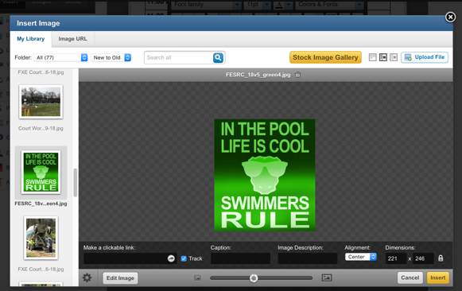
Creating an email Cont.
To edit a picture, just double click onto the picture you want to edit or replace.
An editing pop up appears. You can replace the photo with one you uploaded, or upload one from here.

Slide 15
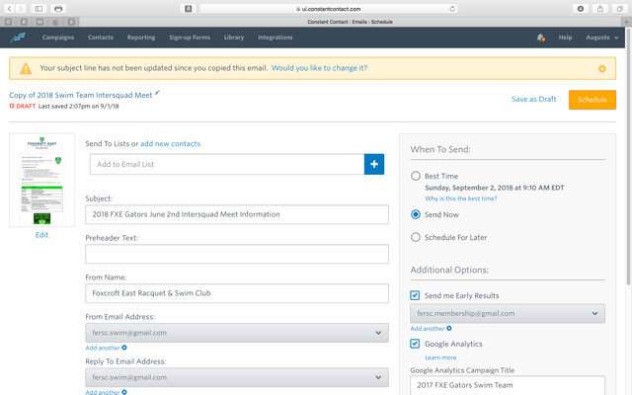
Creating an Email Cont.
Once happy with email click Save in the toolbar and Continue at the top of the window. Now it will take you to a Scheduling window.
Here need to:
Change title
Add email lists for the email
Schedule email. “Schedule for later.” Do not take recommendation. Determine what you think is the best time and day for it to go out.
Select “Schedule” and it is ready to go. You can remove the email from being scheduled if you don’t want it to go out.
If you don’t want to schedule now, you can always select, Save as Draft and schedule later.

Slide 16
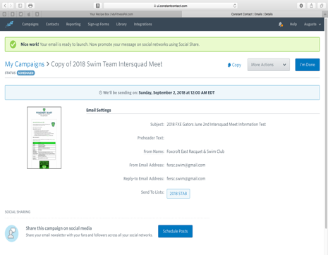
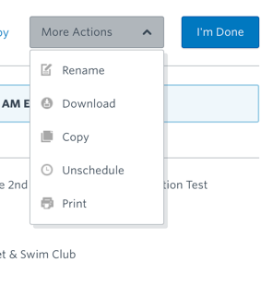
Creating an Email Cont.
Now email is scheduled to go out. Click “I’m Done.”
Under More Actions, you can Unschedule an email and it will sit as a draft.

Slide 17
Creating an Email: The Email account
These emails are assigned to a FXE swim team gmail account fersc.swim@gmail.com . You will need access to that account and make sure all your emails have iy in from and reply.

